Slide 1

DATABASE
TECHNOLOGIES
Query Processing and Optimization
Suresh Jamadagni
Department of Computer Science
and Engineering

Slide 2

DATABASE TECHNOLOGIES
Query processing and optimization
Suresh Jamadagni
Department of Computer Science and Engineering

Slide 3
DATABASE TECHNOLOGIES
Query Execution
Nested Loop Join
In this approach, one of the two arguments has its tuples read only once, while the other argument will be read repeatedly.
Nested-loop joins can be used for relations of any size; it is not necessary that one relation has to fit in the main memory

Slide 4
DATABASE TECHNOLOGIES
Query Execution
Tuple-Based Nested-Loop Join
The simplest variation of nested-loop join has loops that range over individual tuples of the relations involved
Compute the join R(X,Y ) S(Y,Z) as follows:
FOR each tuple s in S DO
FOR each tuple r in R DO
IF r and s join to make a tuple t THEN
output t;

Slide 5
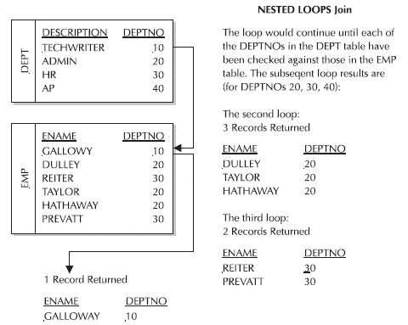
DATABASE TECHNOLOGIES
Query Execution
Tuple-Based Nested-Loop Join example
Select E.ENAME, D.DEPTNO
From EMP E, DEPT D
Where E.DEPTNO = D.DEPTNO

Slide 6
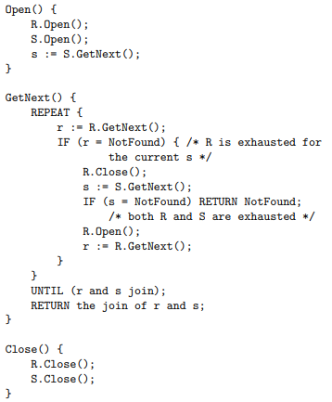
DATABASE TECHNOLOGIES
Query Execution
An Iterator for Tuple-Based Nested-Loop Join

Slide 7
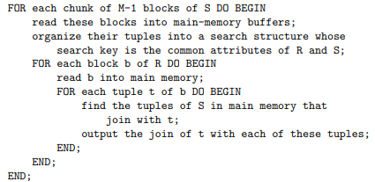
DATABASE TECHNOLOGIES
Query Execution
Block-Based Nested-Loop Join
Compute the join R(X,Y ) S(Y,Z) as follows:
Organizing access to both argument relations by blocks
Using as much main memory as we can to store tuples belonging to the relation S, the relation of the outer loop. This enables to join each tuple of R that is read with not just one tuple of S, but with as many tuples of S as will fit in memory

Slide 8
DATABASE TECHNOLOGIES
Query Execution
Block-Based Nested-Loop Join Example
Consider B(R) = 1000, B(S) = 500 and M = 101.
Let’s use 100 blocks of memory to buffer S in 100-block chunks, so the outer loop will iterate five times.
In each iteration, we need to do 100 disk I/O’s to read the blocks of S and we must read R entirely in the second loop, using 1000 disk I/O’s
Therefore, the total number of disk I/O’s = (100 + 1000) * 5 = 5500.
If we reverse the role of R and S, the total number of disk I/O’s = (100 + 500) * 10 = 6000
In general, there is a slight advantage to using the smaller relation in the outer loop

Slide 9
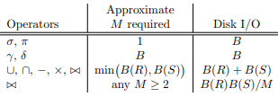
DATABASE TECHNOLOGIES
Query Execution
Analysis of Nested-Loop Join
Assuming S to be the smaller relation, the number of chunks, or iterations of the outer loop is B(S)/(M − 1)
In each iteration, M − 1 blocks of S and B(R) blocks of R are read
Therefore, the number of disk I/O’s = {(M-1) + B(R)} * {B(S) / (M – 1)}
= B(S) + {B(R) * B(S) /(M - 1)}
Summary:
Main memory and disk I/O requirements for one-pass and nested-loop algorithms

Slide 10
THANK YOU
Suresh Jamadagni
Department of Computer Science and Engineering
sureshjamadagni@pes.edu

